Slide 1

Process Improvement Project
“Starting Strength”
By: Gary Chen

Slide 2
“Starting Strength”
Process owner: Gary Chen
Key Dates --->
October 12, 2020 to
December 6, 2020
Define
Measure
Analyze
Improve
Control
DEFINE
MEASURE
ANALYZE
IMPROVE
Histogram shows I got more than 7 hours of sleep 59% of the time.
Chi-Square test shows sleep and calorie goals are independent.
Normal Distribution shows I have a 71% probability of stretching more than 10 minutes.
I hit at least 84% of old lifting output for every exercise.
Moving average forecast for next workout shows my lifting output will be the same to my previous workout.
SQL is low
My improve process started early by deciding on following the “Starting Strength” work out program.
After 3 weeks of analyzing my data, I noticed I was causing a lot of defects to my process.
I mapped out a process map to better conceptualize on how to stay on track.
The problem is lost of my weightlifting strength due to Covid-19 gym shutdowns.
Measure my weightlifting numbers as the Y output of the process.
When gyms opened back up in September 2020, I did not have a plan or program to rebuild workout habits and strength.
My inputs that will affect my output:
Sleep habits
Eating habits
Workout habits
Health/body maintenance
CONTROL
Be mindful of not drinking too much
Consistently log workouts
Stretch for at least 10 minutes
Make it a goal to get at least 7.5 hours of sleep every night
Continue to have a daily calorie goal

Slide 3
DMAIC: Define
Problem statement: My problem is the lost of my weightlifting strength due to Covid-19 gym shutdowns.
My goal is to gain back my strength and workout habits that got disrupted by the gym shutdowns. My working set numbers for bench, squat, military press, & deadlift were significantly down to 225lbs, 175lbs, 85lbs, & 265lbs, respectively. My goal is to gain back 90% of my pre-COVID-19 strength in 8 weeks.
When the gyms opened back up in September, I did not have a workout schedule or program. For this project, I want to follow the “Starting Strength” workout program and improve my process in rebuilding my workout habits.
When gyms initially opened back up, I went to the gyms whenever I felt like it and did not follow a regime. I wasn’t worried about other factors like sleep, diet, or stretching.
I am targeting to go to the gym 3 times per a week for 8 weeks. Ideally, I want to workout 24 times in that span.
My inputs for my weightlifting output will be from sleep, eating habits, and body maintenance.

Slide 4
DMAIC: Measure
Most of the data that I am using for this project is collected manually.
The data collection period will run 8 weeks from October 12th through December 6th
My goal is to collect 24 workout sessions doing the “Starting Strength” program. I want to follow the program and get back in the habit of going to the gym 3 times a week.
I’ll record the working set pounds lifted on each exercise for every workout. This is my continuous output. The gym, date, and time that I start my workout will also be recorded.
The inputs of sleep habits are hours of sleep I get every night and CPAP machine usage. My sleep hours is continuous since I am recording half/quarter hours of sleep. My CPAP usage has discrete values of “Entire”, “Partial”, or “No”.
The inputs of eating habits are calorie goal target, alcohol intake, and weekly weight-ins. Calorie goal target is discrete since I’ll only record if I hit the daily 2,800 calorie goal(yes/no). My alcohol intake value is continuous by recording how many drinks I have on a given day. Weekly Tuesday weight-ins is a continuous value.
The inputs for body maintenance are stretch duration before every workout and physical therapy session counts and analysis. Stretch duration is continuous and PT analysis is discrete.

Slide 5
Data Measurement Plan
How Will Data Be Collected
Who Will Collect
Data
When Will Data Be Collected
Target
Sample
Size
Performance Measure
Data Source and Location
Pounds I lift for each exercise (squat, bench or military press, & deadlift) on every work out. Compare numbers at end of 8 weeks to see if I hit the 90% goal of Pre-Covid-19 numbers
Numbers recorded on workout log after each workout
10/12 - 12/6
24 sessions
Manual data collection
Me
Manual data collection
Calculated from records of work out days
Me
10/12 - 12/6
8 weeks
Number of workouts I do each week
Stretch duration of each workout. Do I usually stretch longer than the recommended 10mins?
Manual data collection
Timed myself on my stretch routine before workouts
Me
10/12 - 12/6
24 sessions
See if different gym location can contribute to strength output
Manual data collection
Recorded on workout log
Me
10/12 - 12/6
24 sessions
Time of day that I start each workout
Manual data collection
Write on workout log, exact time of when I get onto the gym floor
10/12 - 12/6
24 sessions
Me
Average hours of sleep I get for each week
Manual data collection
Calculated from recorded daily sleep hours table
Me
10/12 - 12/6
8 weeks
CPAP usage from each night to measure sleep quality
CPAP machine
Compared CPAP hours to hours of sleep that night
Me
10/12 - 12/6
56 days
Total Alcohol drink intake each week
Manual data collection
Count each drink as I finish them on a given night
Me
10/12 - 12/6
8 weeks
Weigh myself each week to gather insight on muscle gains
Digital scale
Weigh myself every Tuesday morning before my first meal
Me
10/12 - 12/6
8 weeks
Record monthly PT session to see if injury prevention measures are adequate
Manual data collection
Analysis provided by my PT
Me
10/12 - 12/6
2 months
Number of days I hit my calorie goals each week
Manual data collection
Pulled from my daily eating records
Me
10/12 - 12/6
8 weeks

Slide 6
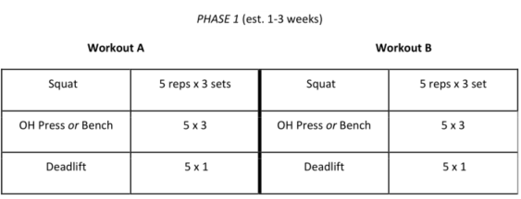
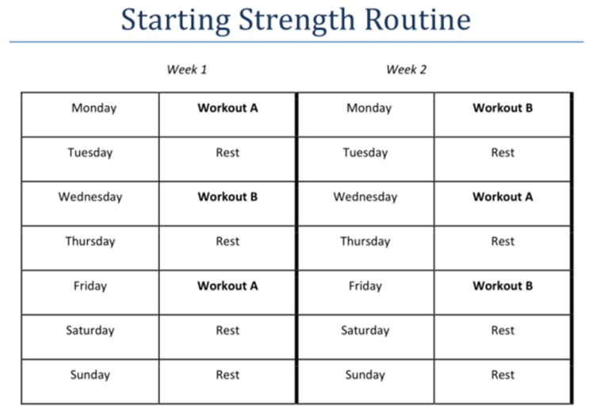
“Starting Strength” program details
Program Logistics:
The workout program has 2 different workouts which each will consist 3 out of the 4 exercises that I’ve mentioned. The workout sessions will alternate between workout A and B. There should be one or two rest days in between workouts.
Baseline:
My goal is to get back 90% of what my old 3 sets of 5 rep numbers were for squatting, military pressing, and benching. For deadlifting, my goal will be to get back 90% of what my old 1 set of 5 rep numbers were since this is a more strenuous exercise and there is only one working set in the “Starting Strength program”.
Pre-Covid numbers(lbs)
Exercise | Bench | Squat | Press | Deadlift
3 x 5 | 255 | 315 | 135 | 355
1 x 5 | 275 | 345 | 155 | 395
1 x 1 | 290 | 365 | 175 | 425
Current Baseline numbers(10/6)(lbs)
Exercise | Bench | Squat | Press | Deadlift
3 x 5 | 175 | 225 | 85
1 x 5 |  |  |  | 265
1 x 1
Goal numbers(After 8 weeks) (lbs)
Exercise | Bench | Squat | Press | Deadlift
3 x 5 | 230 | 285 | 125
1 x 5 |  |  |  | 355
1 x 1

Slide 7
Potential Measurement Errors:
Since most of the project consist of manual data collection, there are many potential areas of measurement errors. The best solution is to be diligent in my process and be mindful of potential errors when it comes time for the analyze phase.
For my weightlifting output, I recorded each working set in my workout logbook as I finished them. My timed stretch duration and other workout details get recorded the same way. Then I put this data in Excel on the same day.
For sleep, I estimate the time that I fell asleep. When I wake up, I record to the closest quarter hour of how much sleep I got for that night on Excel. Sleep quality is measured with CPAP usage. Sometimes I forget to put on my mask, or I take it off subconsciously. I record that input in the morning too.
The input most prone to measurement errors is my eating habits. The Calorie Goal input requires my own intuition on if I hit 2,800 calories each day. This is challenging since I do not prepare my own meals. It is hard to record the exact calories on each meal I eat but I have a lot experience in estimating calories. I must be mindful of the portions I am eating and how frequently I eat. There are days where I barely miss the goal and days where I easily ate more than 2,800 calories. This measure does not account for that. It is too challenging to record the exact daily calorie count. It is more important if I hit the goal than heavily going over it. Every night before bed, I record this input on my Excel file. My weekly weight-ins give further analysis on if I really do hit my calorie goals. I made sure to weight myself every Tuesday morning after I use the restroom and before I have my first meal to minimize the weight fluctuations that people have throughout the day.
Alcohol intake is also prone to errors since it is hard to keep track of that when you’re having a good time. I did my best to record each drink I have as I finish them on my phone. Drinks have different alcohol percentages. A beer and a shot counted the same but the best way I accounted for this was I mostly stuck to beer and seltzers when I was drinking to keep alcoholic units of measurement somewhat consistent. This wasn’t perfect but it gave us an idea of the effects that alcohol has had on my weightlifting output and habits.

Slide 8
DMAIC: Analyze
I was able to get 23 workout sessions which was 1 off from my goal. I recorded 56 daily entries of sleeping and eating habits. I recorded 8 weekly weigh-ins and 2 physical therapy sessions.
As seen from my hours of sleep histogram, I was able to get more than 7 hours of sleep(59%) 33 days out of the 56 days. 7 hours is the bare minimum required for an adult. For someone with a more active lifestyle, my body should require more than 7 hours. There is room for improvement in getting more sleep. More sleep will most likely improve my muscle recovery to maximize my lifting output. It is much harder to be alert with less than 7 hours of sleep.
I applied the Chi-Square test to see if adequate sleep and hitting my calorie goals were linked together. The test showed that adequate sleep and hitting 2,800 daily calories are independent. Intuitively we would think sleep would affect appetite, but the test of this sample states otherwise.
I ran a normal distribution test on me stretching more than the recommended 10 minutes before a workout. The test returned a 71% chance that I’ll stretch longer than 10 minutes. While that is a good probability, there is room for improvement to at least 90%+.
Moving average forecast shows my next workout output will be very similar to my previous one.

Slide 9
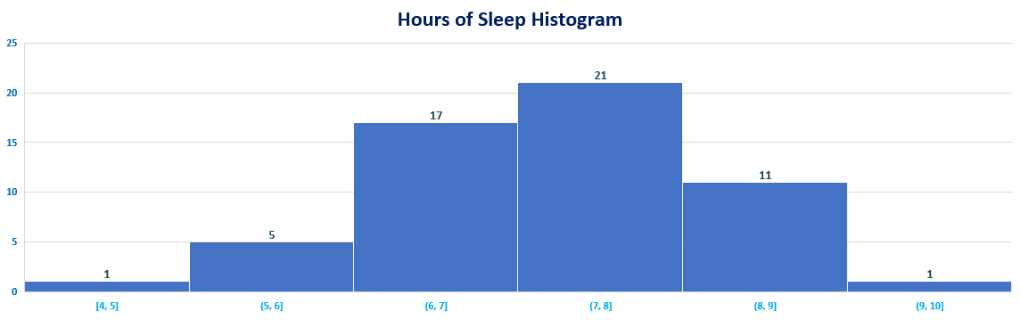
Sleep Chart
Days
Hours

Slide 10
Chi-Square Test- Sleep vs Calorie Goal
P-value for this test is 0.103206
It is higher than 0.05 which means we must accept the null-hypothesis.
Sleep and reaching 2,800 calories are independent and there is no relationship.
Split hours of sleep into two bins:
-Getting 7.5 hours of sleep or more
-Getting less than 7.5 hours of sleep

Slide 11

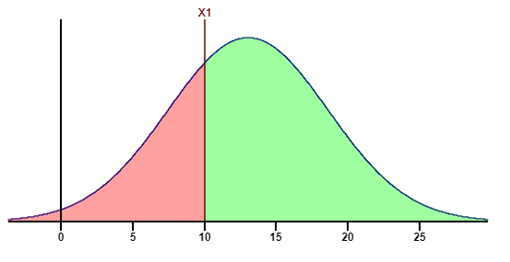
Normal Distribution: What is the probability that I stretch longer than the recommended 10 minutes before exercising?
X = 10 minutes
u/mean = 13.05 minutes
Standard deviation = 5.57 minutes
Normal distribution = 0.29218
Want probability of longer than 10 minutes 1 – 0.29218 = 0.70782
There is approximately 71% probability that I will stretch longer than 10minutes

Slide 12
Moving Average Forecast
Workout Session | Squat Actuals | Moving Average | Deadlift | Moving Average |  | Workout Session | Bench | Moving Average |  | Workout Session | Press | Moving Average
1 | 225 |  | 245 |  |  | 1 | 175 |  |  | 2 | 95
2 | 235 |  | 265 |  |  | 3 | 185 |  |  | 4 | 95
3 | 245 |  | 275 |  |  | 5 | 185 |  |  | 6 | 105
4 | 245 | 235 | 275 | 261.6666667 |  | 7 | 195 | 181.6666667 |  | 8 | 105 | 98.33333333
5 | 245 | 241.6666667 | 275 | 271.6666667 |  | 9 | 195 | 188.3333333 |  | 10 | 115 | 101.6666667
6 | 255 | 245 | 285 | 275 |  | 11 | 205 | 191.6666667 |  | 12 | 115 | 108.3333333
7 | 255 | 248.3333333 | 295 | 278.3333333 |  | 13 | 205 | 198.3333333 |  | 14 | 115 | 111.6666667
8 | 265 | 251.6666667 | 295 | 285 |  | 15 | 205 | 201.6666667 |  | 16 | 115 | 115
9 | 265 | 258.3333333 | 295 | 291.6666667 |  | 17 | 215 | 205 |  | 18 | 115 | 115
10 | 275 | 261.6666667 | 295 | 295 |  | 19 | 215 | 208.3333333 |  | 20 | 115 | 115
11 | 275 | 268.3333333 | 305 | 295 |  | 21 | 215 | 211.6666667 |  | 22 | 115 | 115
12 | 275 | 271.6666667 | 305 | 298.3333333 |  | 23 | 215 | 215 |  | 24 |  | 115
13 | 275 | 275 | 305 | 301.6666667 |  | 25 |  | 215
14 | 285 | 275 | 315 | 305
15 | 285 | 278.3333333 | 315 | 308.3333333
16 | 285 | 281.6666667 | 315 | 311.6666667
17 | 295 | 285 | 335 | 315
18 | 295 | 288.3333333 | 335 | 321.6666667
19 | 295 | 291.6666667 | 335 | 328.3333333
20 | 295 | 295 | 345 | 335
21 | 295 | 295 | 345 | 338.3333333
22 | 300 | 295 | 345 | 341.6666667
23 | 300 | 296.6666667 | 345 | 345
24 |  | 298.3333333 |  | 345
- The moving average forecast for my next workout shows that I will probably lift the same number of pounds that I lifted on my previous workout. This makes sense since my current working sets are very heavy. It will take more time for me to break out of this plateau.

Slide 13
Working Set Output After 8 Weeks:
Target vs Actuals |  |  |  |  |  | Dollar Calculations
Exercise | Bench | Squat | Press | Deadlift |  |  | 80% | 90% | 100% | 100%+ | 1 rep bonus
Previous Numbers | 255 | 315 | 135 | 395 |  | Bench | $1,000 | $1,500 | $2,500 | $2400 + $1.30(lbs) | $1.15(lbs)
Target Goal | 230 | 285 | 125 | 355 |  | Squat | $1,000 | $1,500 | $2,500 | $2400 + $1.25(lbs) | $1.10(lbs)
Actuals | 215 | 300 | 115 | 345 |  | Press | $1,000 | $1,500 | $2,500 | $2400 + $1.35(lbs) | $1.20(lbs)
% actuals vs previous | 84% | 95% | 85% | 87% |  | Deadlift | $1,000 | $1,500 | $2,500 | $2400 + $1.20(lbs) | $1.05(lbs)
Business impact calculation: $1000 + $1500 + $1000 + $1000 = $ 4,500.00
At the end of this program, I was able to reach my goal in squats.
I missed my target on bench, military press, and deadlifts but I was very close.
I missed my target goal of 24 workout sessions by 1. I was able to workout 23 times in the 8-week time frame.
The business impact measurement guidelines were stated before the start of the program. The dollar amount that my output produced is $4,500. Not a bad for 8 weeks of fun.

Slide 14
SQL- Sigma Quality Level
The defects in my process will be measure per a week. If I do not work out 3 times a week, that is a defect. If I do not hit my calorie goal at least 5 times a week, it is a defect. If I drink more than 5 alcoholic drinks a week, it is a defect. If I average less than 7.5 hours of sleep a week, that is a defect.
1. Defect opportunity per a week: D = 4
2. There are a total of 8 weeks: U = 8
3. Total possible defects: D x U = 32
4. Total actual defects: A = 14
5. Defect-per-opportunity rate: A / DU = DPO = 0.4375
6. Defects per million opportunities (DPMO): 437,500
7. SQL value = 1.6, Yield = 54.00%
My SQL is kind of low. As I am analyzing the actual defects, Most of them happened between weeks 1-3. From weeks 1-3, I had 10 defects. From weeks 4-8, I had 4 defects.

Slide 15
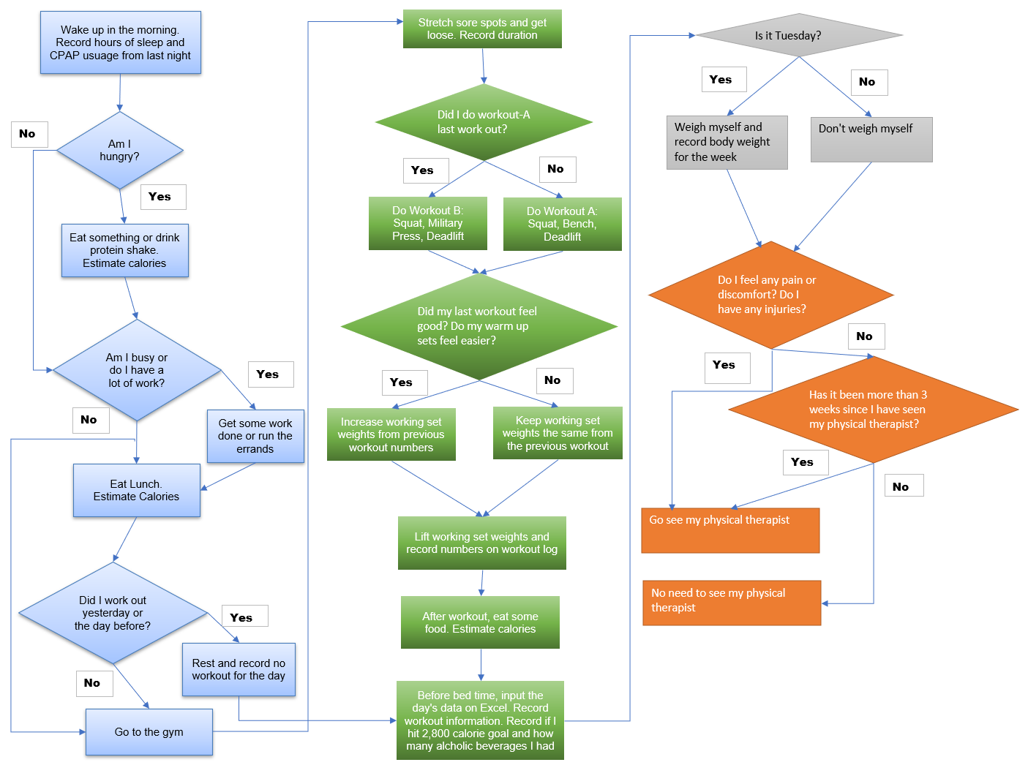
Process Map
This is the process map that I followed from the 3rd week onwards. It was a step forward to improve keeping track and following the “Start Strength” program.

Slide 16
DMAIC: Improve
As soon as I decided to start the “Starting Strength” program, I began the improvement process to my lost of strength problem. On the first three weeks, I found it hard to follow the program. It was very taxing on the body. I missed my weekly work out goals on week 1 and week 3.
When I looked at the first three weeks of data, I noticed that I was drinking a lot and did not hit my calorie goals on half the days. I decided to map out my process to improve my gym frequency and to better record my data points.
As shown from my SQL analysis, I committed less defects once I mapped out my process and was more aware of the potential defects that I was committing. I cut back on drinking which increased my gym frequency and lifting numbers immensely. After this improvement phase, there were two weeks where I went to the gym 4 times per a week. It made up the lost workout sessions in the early weeks of this process. I started off slow but was able to adjust my process to hit at least 84% of my old lifting set numbers.
I learned I was able to hold myself more accountable when I mapped out my process more clearly and had data to look back on. I learned how much alcohol disrupts my workout frequency. From tracking my sleep, I learned to be more mindful of when I went to bed and when I woke up. I learned how much sleep I was getting which helped explained why some days felt better or worst.

Slide 17
DMAIC: Control
I learned a lot in the improvement phase.
I need to be consistent on not drinking too much.
I need to continue to record and log my workouts to keep me on a consistent program.
I should stretch for at least 10 minutes before every workout.
Make a new goal of getting at least 7.5 hours of sleep a night.
Continue to have a calorie goal to fuel my workouts and muscle gain.
See my physical therapist more often.

